Slide 1





Greta Swanson
Environmental Law Institute
August 14, 2024
ADVANCING TRIBAL SOVEREIGNTY IN STATE AND LOCAL
TRIBAL CONSULTATION
National association
of tribal historic
preservation officers
Swinomish elder
larry campbell† &
Dr. Jamie donatuto
NATIVE AMERICAN RIGHTS FUND/NATIONAL INDIAN LAW LIBRARY
Dry Creek rancheria band of pomo Indians
Support for this project was provided by the Robert Wood Johnson Foundation’s Policies for Action program and the Henry Luce Foundation.The views expressed here do not necessarily reflect the views of the Foundations.
Notes:
Context: Cultural heritage both powerful yet fragile. Our project is focused on how government-to-government consultation can help Tribes protect their cultural heritage and environmental interests and, ultimately, health and wellness.

Slide 2
TRIBAL CONSULTATION IN California
Effectiveness of two California laws – SB 18 and AB 52 – from perspective of Tribes
Challenges of sub-national Tribal consultation
Study: Interviews, case studies, Indigenous Health Indicators,
Tribal survey, recommendations

Slide 3
SURVEY Results - trends
Tribal goals for consultation under SB 18 and AB 52
Increased opportunities for consultation
Limitations to effectiveness
Minority: laws promoted resolution of issues
and healing for Tribal members

Slide 4
SURVEY Results – KEY ISSUES
Confidentiality
Relationships
Resources

Slide 5
SURVEY RESULTS – KEY ISSUES
      Notification
      Consultation timeline
      Consultation protocols
      Tribal knowledge/expertise
      Creative mitigation
      Accountability

Slide 6
TRIBAL CONSULTATION DIGITAL HUB
Free online resource of Tribal consultation policies/laws nationwide
  Tribes
  States
  Federal government
  Agencies
  Some local governments
Phase 2 (coming soon)
  consultation resources
  results of ELI’s research on Tribal consultation in California and other states
Henry Luce Foundation support

Slide 7
Tribal consultation digital Hub
Procedure for including policies of Tribes
  Publicly available policies
  Option to opt out
  Option to rescind permission
Listings include
  Title
  Policy abstract
  Link to policy or resource
  Pdf for most state and Tribal policies

Slide 8
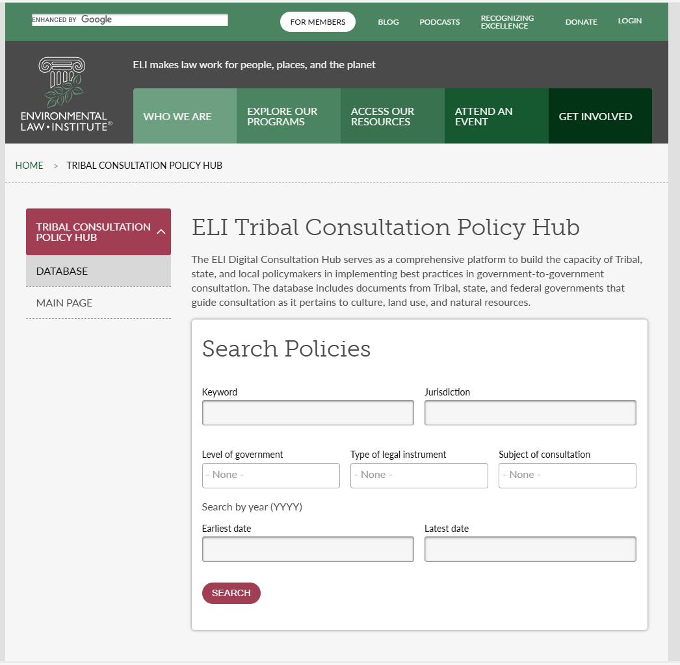
TRIBAL CONSULTATION DIGITAL HUB
-CONDUCTING A SEARCH

Slide 9
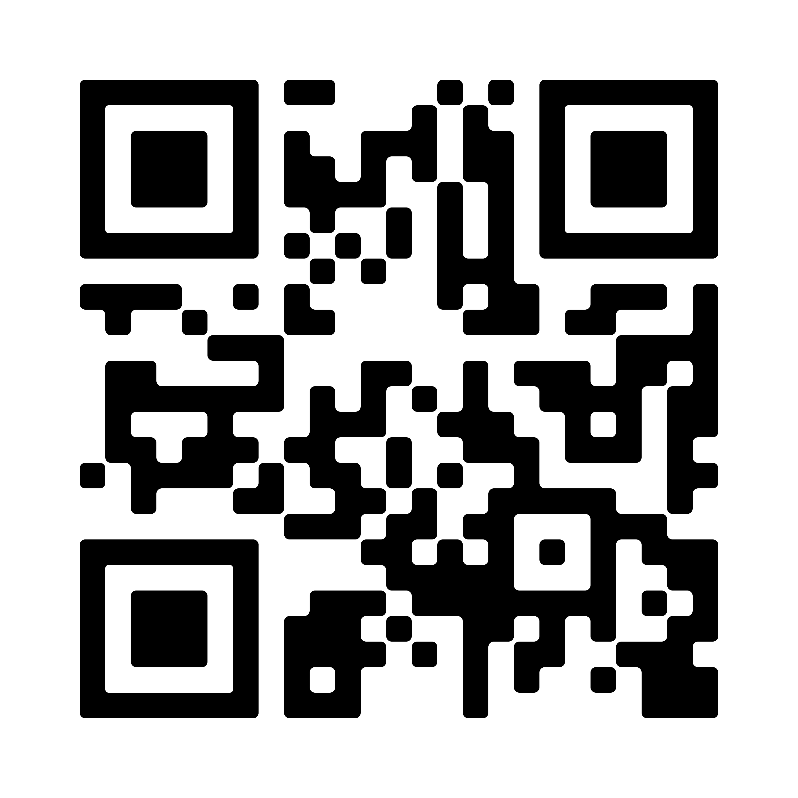
THANK YOU!
LINKS TO THE TRIBAL CONSULTATION DIGITAL HUB:
http://Eli.org/tribal-policies
QUESTIONS AND FEEDBACK:
consultationhub@eli.org
CONTACT:
Greta Swanson
swanson@eli.org

